Slide 1






Six Exciting Benefits Of Longevity Science

Slide 2







Longevity Science
What if we could hit the 'mute' button on aging and amplify not just our lifespan, but also our healthspan (the number of years we spend living disease-free)? Welcome to the frontier of Longevity Science!"
Aging

Slide 3


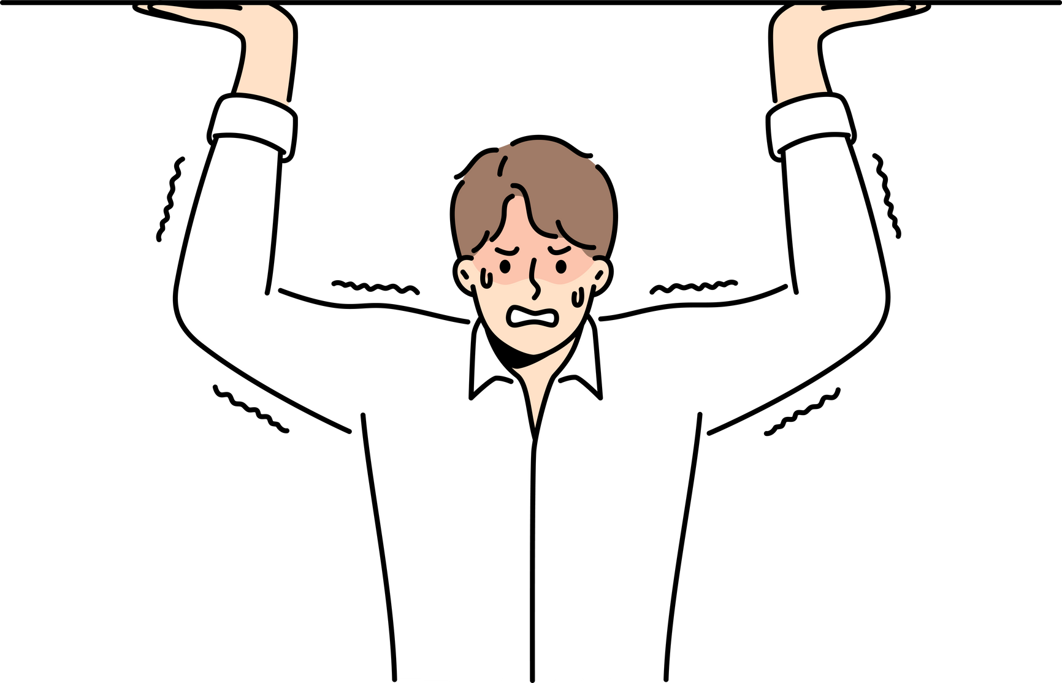
1. Reduce The Healthcare Burden
As we get older, scientists are working to keep our bodies strong and healthy, so we can have more fun and spend money on fun things!"

Slide 4
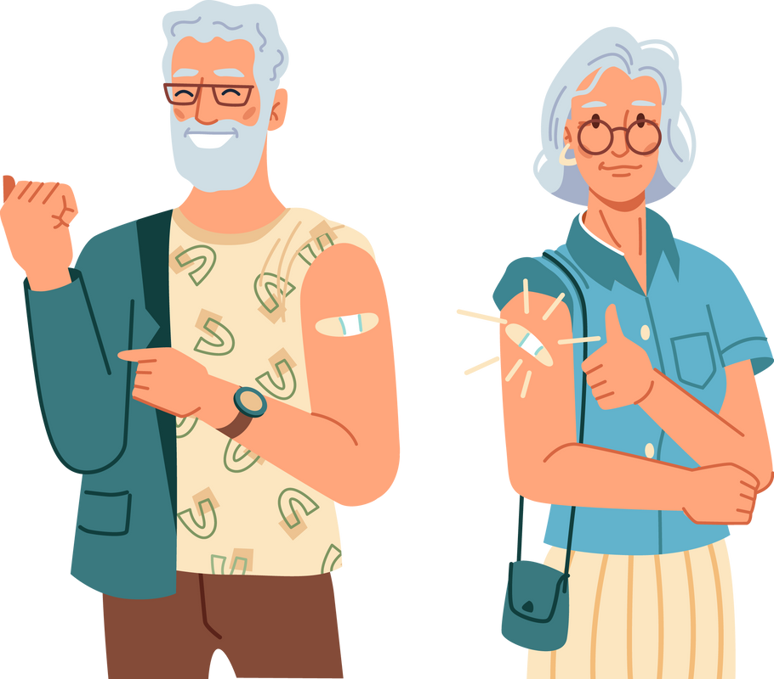

2. Boost Economic Prosperity
Imagine if everyone stayed healthy and lived longer - it would make our communities super strong and we'd have more fun and cool stuff to do!

Slide 5

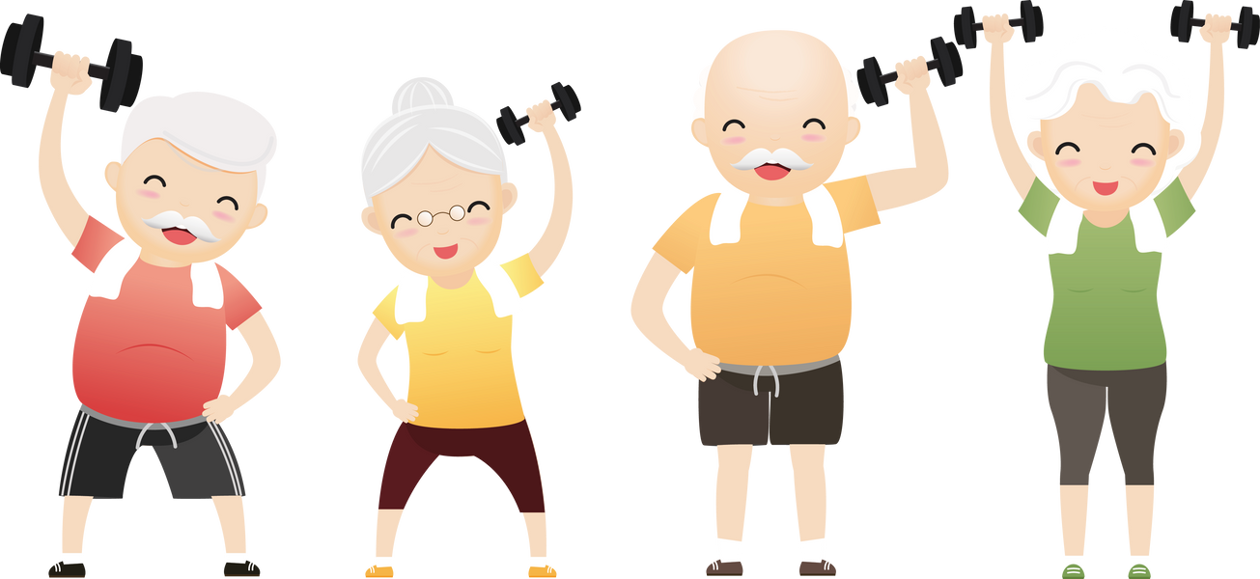
3. Empower Older Adults
Picture a world where 2 billion people not only live long lives but thrive with strong health and endless energy.

Slide 6

4. Expand Human Potential
Picture a world where Einstein, Edison, and Tesla could have kept inspiring us into their 200s.

Slide 7
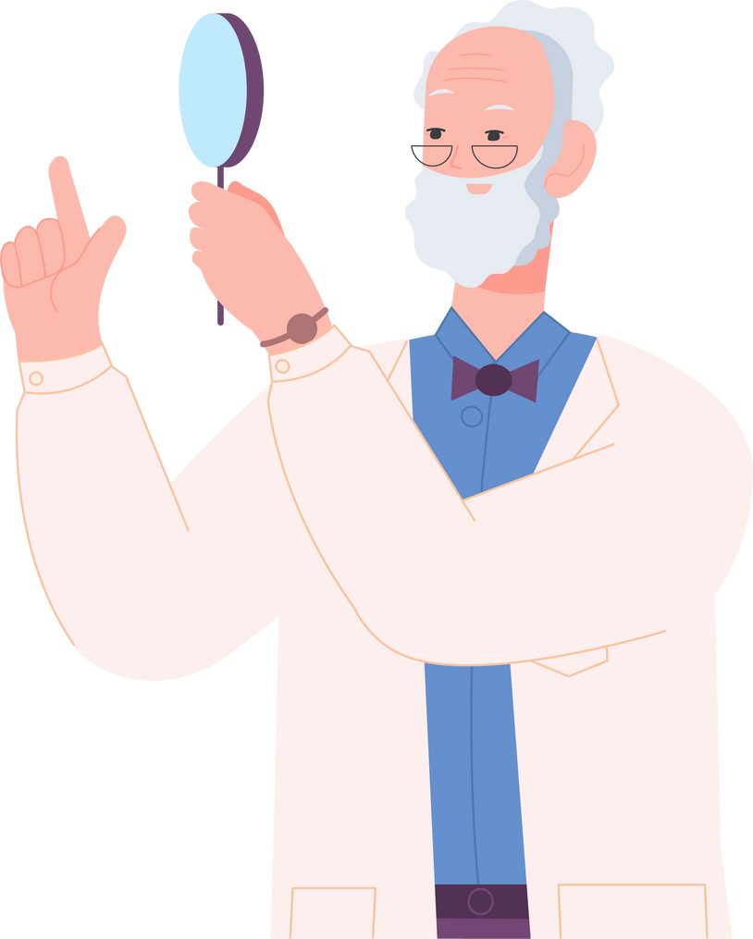


5. Preserve Knowledge
Imagine a world where people with decades of knowledge worked into their 200s.

Slide 8
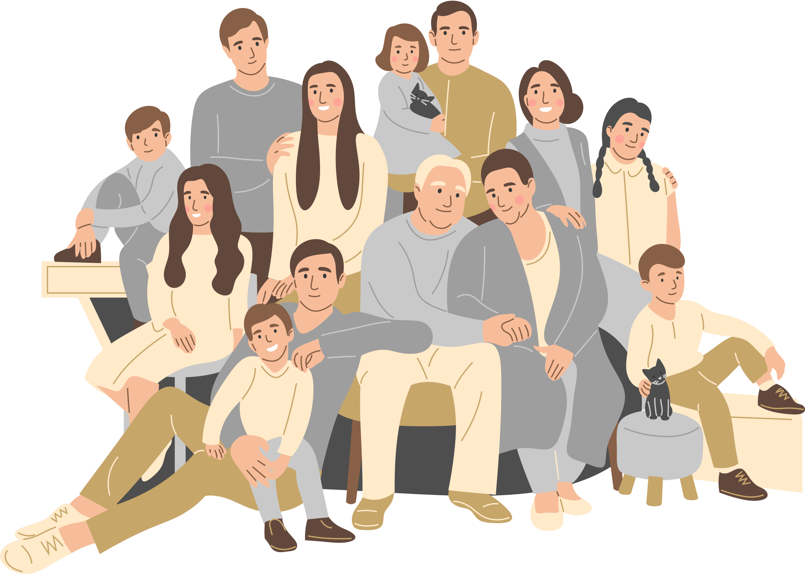

6. Strengthen InterGenerational Bonds
Picture five generations playing happily or celebrating a family member's 200th birthday. This is the future of families, filled with strong bonds and great support!"

Slide 9



Things To Remember
Imagine wise people helping for a very long time!"
Sometimes, smart minds can get tired. But what if they stayed super smart?
People could do amazing things for a super long time!

